Slide 1

PaDiM: a Patch Distribution Modeling Framework for Anomaly Detection and Localization
Paper review
Gibeom Kim (UST)
Notes:
i’m master’s degree student of prof.Hyejin kim.
I'm interested in the anomaly detection and I decided to review this paper because this model is often used as a base model of anomaly detection task.

Slide 2

Index
Paper abstract
1-1. Anomaly Detection
1-2. Mahalanobis Distance
Model
Conclusion
Notes:
I don't know how much you know about Padim, so I’ll explain a quick overview of the basics of Padim

Slide 3
1. Paper abstract
By using pre-trained CNN models and Gaussian Distribution for anomaly detection in images
The embedding vector is obtained from CNN model and computed to get Mahalanobis distance patch-by-patch.
Embedding vector is extracted from each layers of the CNN model, is used for considering correlations at different semantic levels.
Each patch is assumed to follow a Multivariate Gaussian Distribution.
Notes:
i’ll explain detail about this content on later slide
전제: Premise

Slide 4
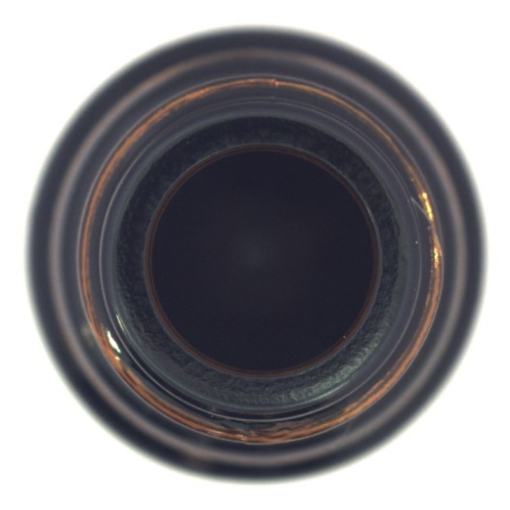
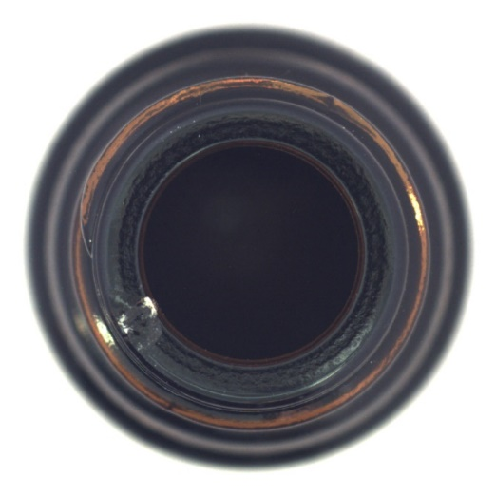
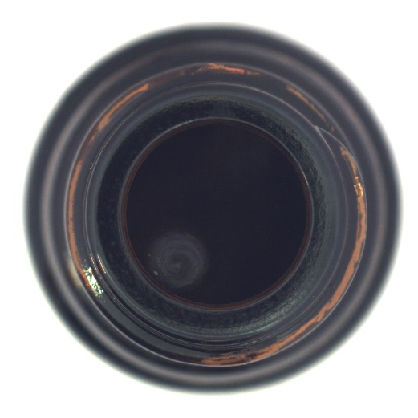
1-1. Anomaly Detection
Task to detect abnormal pattern or values from the data
Train a model using only normal images and then determine whether a given image is normal or abnormal.
In industrial site, it is easy to get normal images, but difficult to get various abnormal images.
Normal image
Abnormal image
Notes:
The mvtec dataset is a representative dataset used for anomaly detection
Images of a bottle viewed from above.
The part marked with a red square is an abnormal point.
Crack
It is difficult to distinguish and specify all these different kinds of defects, so we only use normal images and judge deviations from normal patterns as abnormal.

Slide 5

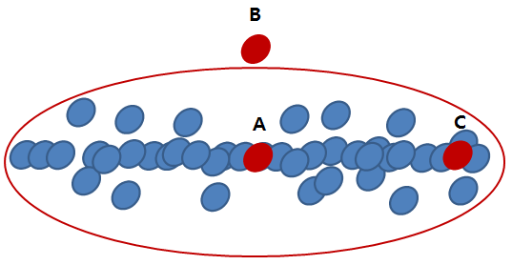
1-2. Mahalanobis Distance
Distance in Probability Distributions
A value that indicates data point is how far from that mean of a distribution by using standard deviation.
x: Individual data values
μ: Mean of the data distribution
S: Covariance matrix of the data distribution
Notes:
The red circle is the set of points that have the same probability value
We can say that C is more likely or more probable than B.

Slide 6
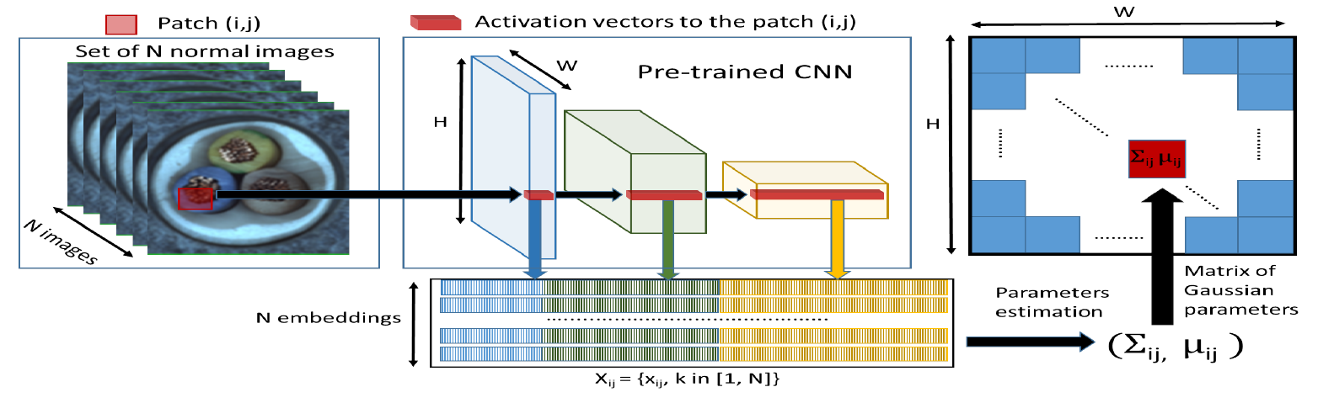
1. Paper Abstract
Simplified data processing flow of a PaDim model

Slide 7



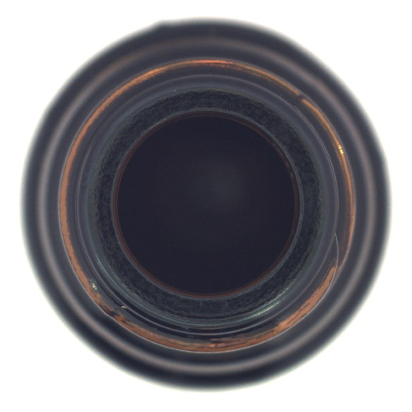



1. Paper Abstract
Original image
Channel image
Notes:
These are images representation of the value of a specific channel of the embedding vector obtained from resnet architecutre.

Slide 8
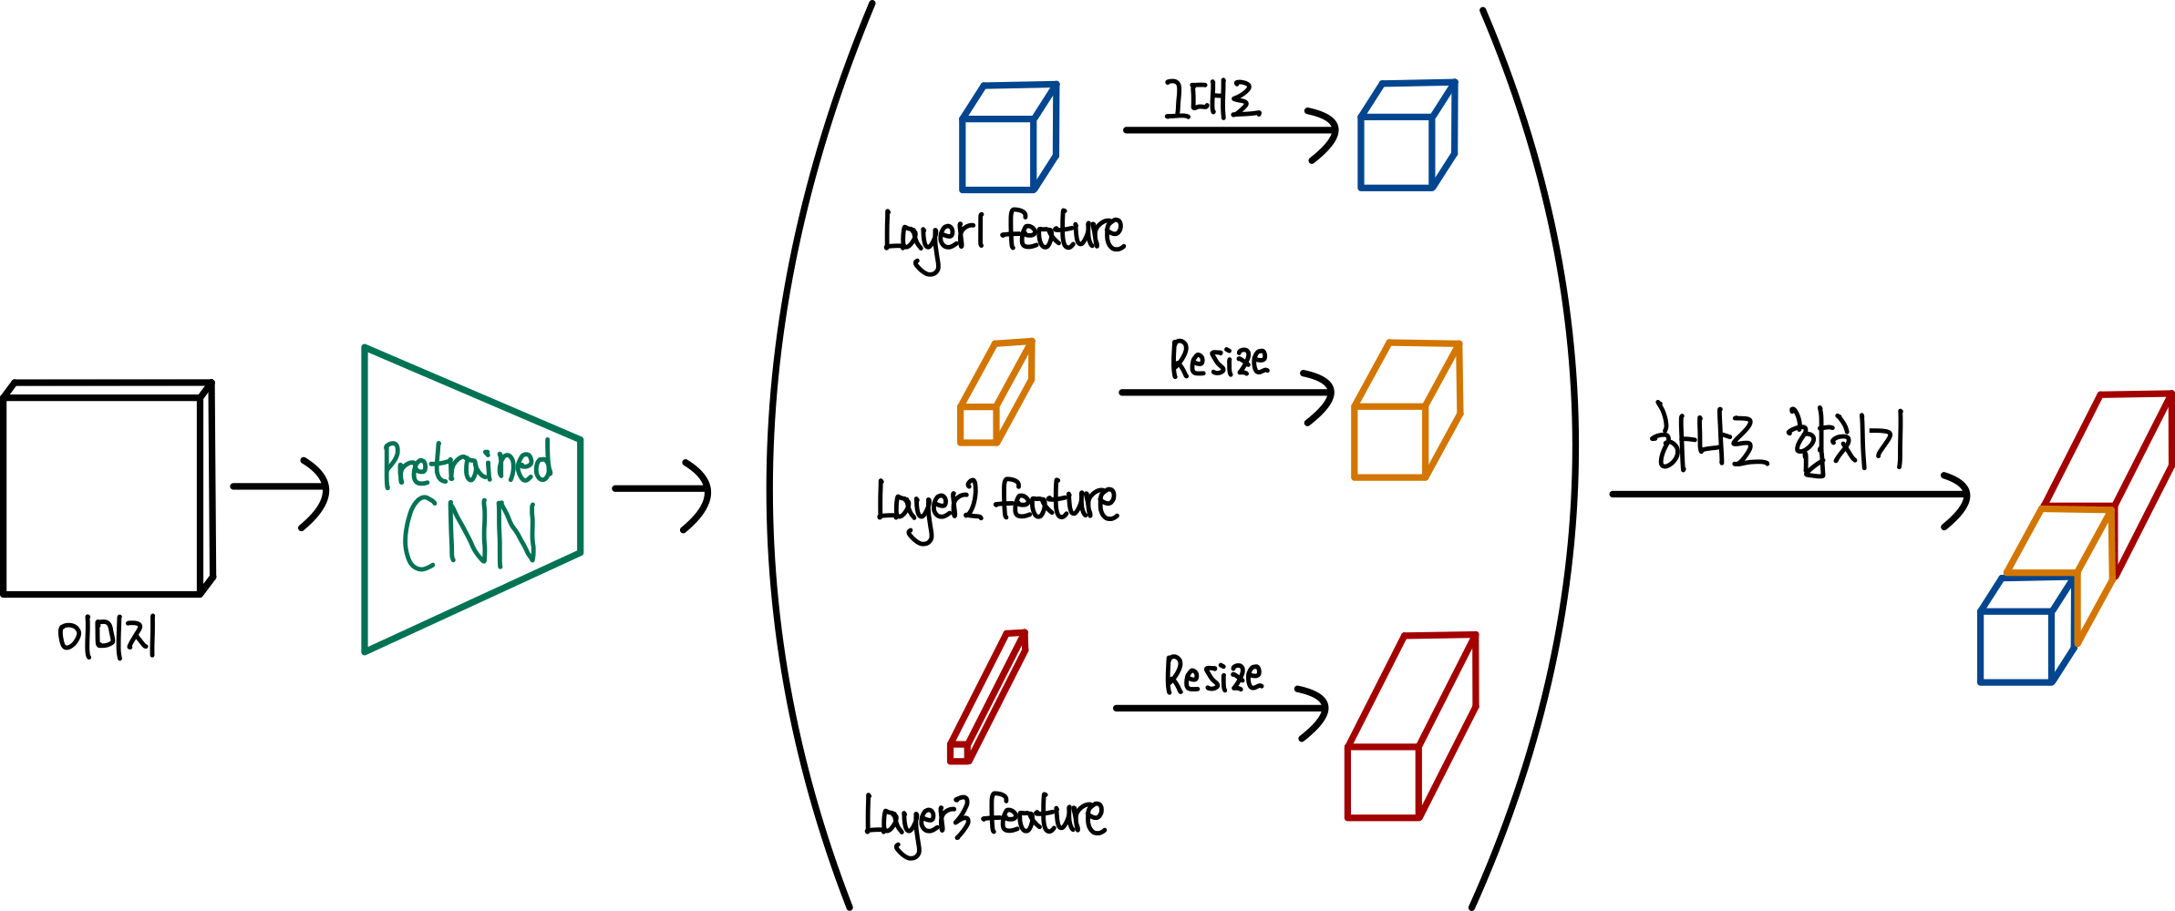
2. Model
Embedding extraction
Concatenate all features extracted from pre-trained CNN layers to a single embedding vector
For dimensionality reduction, part of channels are used to calculate mean and covariance

Slide 9
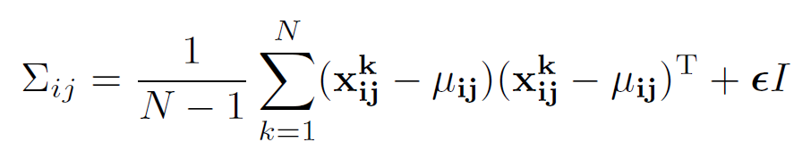

2. Model
Learning of the normality
Compute the covariance matrix and mean value for each patch
Use all training data to compute covariance matrix and mean
$$x_{ij}^{k}:The patch embedding vector of location \left(i, j\right) in the k−th$$
$$training image.$$
$N:The total number of normal training images.$
$μ_{ij}:The mean of X_{ij}, which is the average of the embedding vectors$ $for all training images at location \left(i, j\right).$
$Σ_{ij}:The covariance matrix of$ $X_{ij}$
$εI:A regularization term that ensures the covariance matrix is$ $full rank, allowing the calculation of the inverse matrix.$

Slide 10
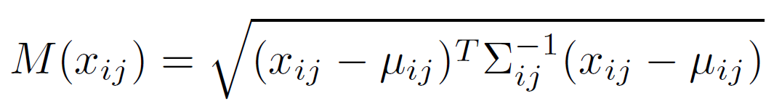
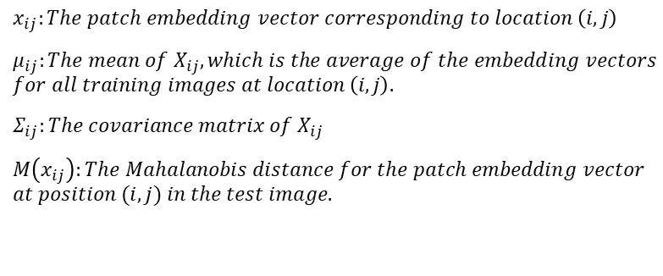
2. Model
Inference : computation of the anomaly map
Test images are input into the pre-trained CNN model as same method as the previous process.
The Mahalanobis distance is calculated to compare how far each patch is from the mean and covariance values of the normal images on a patch-by-patch.
$$x_{ij}:The patch embedding vector corresponding to location \left(i, j\right)$$
$μ_{ij}:The mean of X_{ij}, which is the average of the embedding vectors$ $for all training images at location \left(i, j\right).$
$Σ_{ij}:The covariance matrix of$ $X_{ij}$
$M\left(x_{ij}\right):The Mahalanobis distance for the patch embedding vector$
$$at position (i, j) in the test image.$$

Slide 11
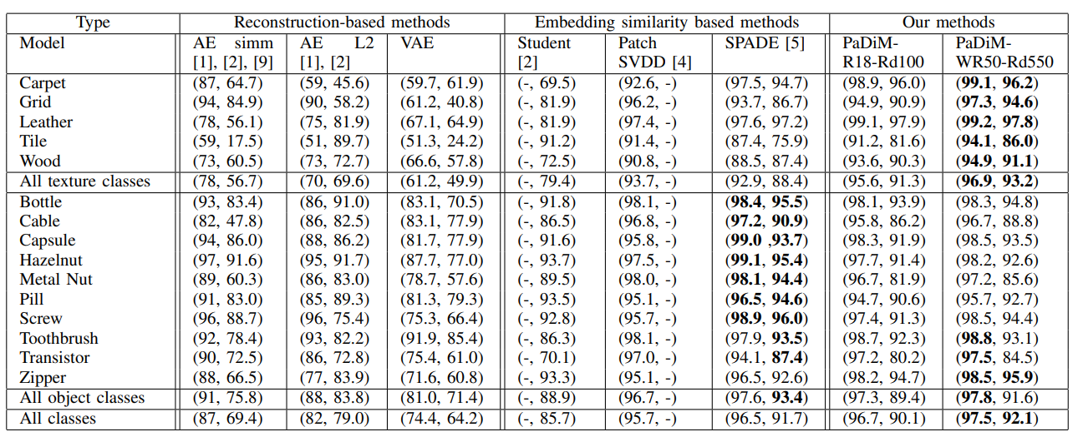
3. Conclusion
Combining the outputs of the first three layers of pre-trained CNN model and considering the correlations between them.
No need to train deep learning model, so inference taking less time. (for example, approximately 150 seconds per class when using cpu)
Achieved State-Of-The-Art (SOTA) in 2020

Slide 12
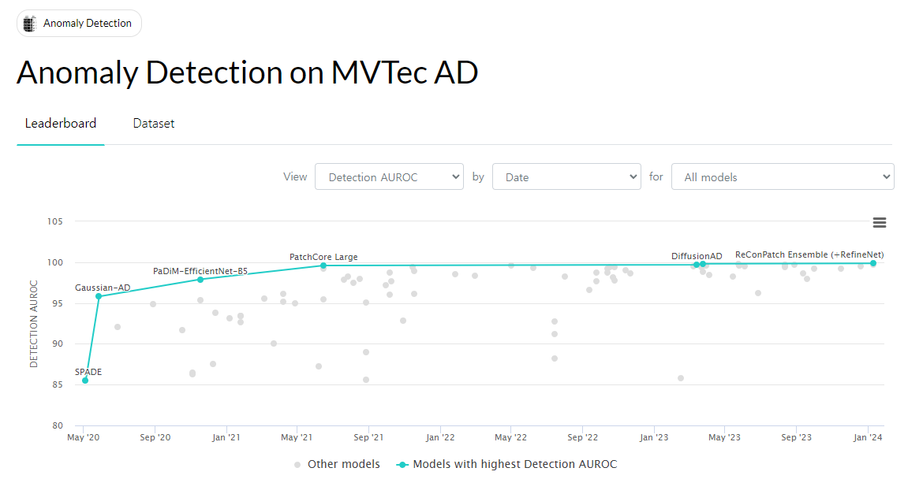
3. Conclusion
Notes:
So we can say that the PADIM model is very important in the anomaly detection task.

Slide 13
Thank you

